Slide 2
Outline
View
PL/SQL blocks,
PL/SQL data types,
Conditional statements and looping,
SQL within PL/SQL,
Error Handling Cursors,
Stored Procedures and Stored Function,
Database Triggers

Slide 3
Views
The view is a virtual table. It does not physically exist. Rather, it is created by a query joining one or more tables.
A view contains rows and columns, just like a real table
The fields in a view are fields from one or more real tables in the database
Creating an SQL VIEW
Syntax:
CREATE VIEW view_name AS
SELECT column_name(s)
FROM table_name
WHERE condition;

Slide 4
Views
View Creation – Example
1. CREATE VIEW transaction_view
AS SELECT acc_no, tr_date,amt from transaction;
2. Create view account_view
AS SELECT a.acc_no,a.balance,l.loan_amt,l.interest_rate from account a, loan l where a.acc_no=l.acc_no and a.city=‘Ahmedabad’;
The above views would create a virtual table based on the result set of the select statement. To show created views:
SELECT * FROM transaction_view;
SELECT * FROM account_view;

Slide 5
Views
Updating View
You can modify the definition of a VIEW without dropping it by using the following syntax:
CREATE OR REPLACE VIEW view_name
AS SELECT columns
FROM table
WHERE predicates;
1. Create or Replace view account_view
AS SELECT a.acc_no,a.balance,l.loan_amt,l.interest_rate, l.remaining_loan from account a, loan l where a.acc_no=l.acc_no and a.city=‘Mehsana’;

Slide 6
Views
Deleting View
The syntax for dropping a VIEW :
DROP VIEW view_name;
View Drop - Example
DROP VIEW transaction_view;

Slide 7
Views
Question: Can you update the data in an view?
Answer : A view is created by joining one or more tables. When you update record(s) in a view, it updates the records in the underlying tables that make up the View. So, yes, you can update the data in View providing you have the proper privileges to the underlying tables.
Question: Does the SQL View exist if the table is dropped from the database?
Answer: Yes, View continues to exist even after one of the tables (that the SQL View is based on) is dropped from the database. However, if you try to query the View after the table has been dropped, you will receive a message indicating that the View has errors.

Slide 8
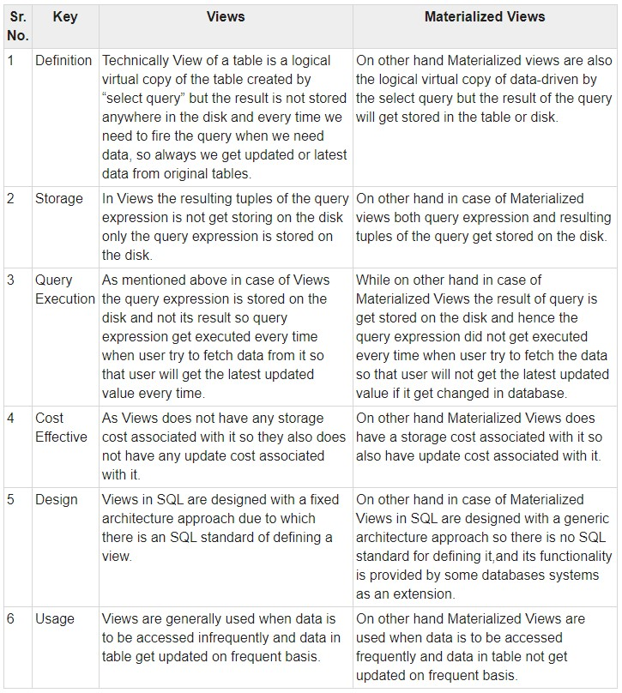
Views

Slide 9
PL / SQL
PL/SQL stands for “Procedural Language extensions to the Structured Query Language.”
SQL is a popular language for both querying and updating data in relational database management systems (RDBMS).
PL/SQL is a highly structured and readable language.
PL/SQL is a standard and portable language for Oracle Database development.
PL/SQL program that runs on a system that does not have an Oracle Database.
PL/SQL is a high-performance and highly integrated database language.

Slide 10
The PL/SQL Comments
Single-line comments
Syntax:
-- valued added tax 10%
Multi-line comments
Syntax:
/*
PL/SQL executable statement(s)
*/

Slide 11
The PL/SQL Comments
Single-line comments
Syntax:
-- valued added tax 10%
Multi-line comments
Syntax:
/*
* PL/SQL executable statement(s)
*/
Single-line comments
Example:
-- This is Comment
Multi-line comments
Example:
/*
PL/SQL Multi line comment
*/

Slide 12
The PL/SQL Comments
Single-line comments
Syntax:
-- valued added tax 10%
Multi-line comments
Syntax:
/*
* PL/SQL executable statement(s)
*/
Single-line comments
Example:
-- This is Comment
Multi-line comments
Example:
/*
PL/SQL Multi line comment
*/

Slide 13
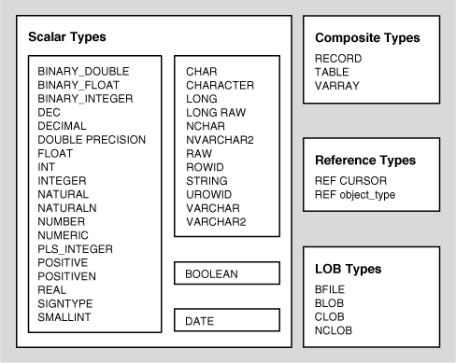
The PL/SQL Data Types

Slide 14
PL/SQL
PL/SQL BLOCK STRUCTURE
DECLARE (optional)
- variable declarations
BEGIN (required)
- SQL statements
- PL/SQL statements or sub-blocks
EXCEPTION (optional)
- actions to perform when errors occur
END; (required)

Slide 15
PL/SQL
There are 2 types of Datatypes:
Scalar (Char, Varchar2, Date and Number)
Composite (%rowtype)
All Variables required to be used in the program must be declared before their use. Variable names cannot be table, column and keyword names.
Assignment Operator is denoted as “:=” and each statement of PL/SQL ends with “;”.
Dbms_Output.Put_Line() is used for printing Output.
&Variable_Name is used to take input from the user.

Slide 16
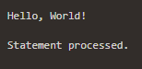
PL / SQL Syntax
Syntax:
DECLARE
<declarations section>
BEGIN
<executable command(s)>
EXCEPTION
<exception handling>
END;
Example: Print The 'Hello World'
DECLARE
message varchar2(20):= 'Hello, World!';
BEGIN
dbms_output.put_line(message);
END;

Slide 17
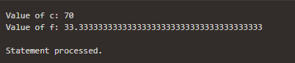
PL / SQL Example
Example: Calculator
-- basic Program
DECLARE
a integer := 30;
b integer := 40;
c integer;
f real;
BEGIN
c := a + b;
dbms_output.put_line('Value of c: ' || c);
f := 100.0/3.0;
dbms_output.put_line('Value of f: ' || f);
END;
/

Slide 18
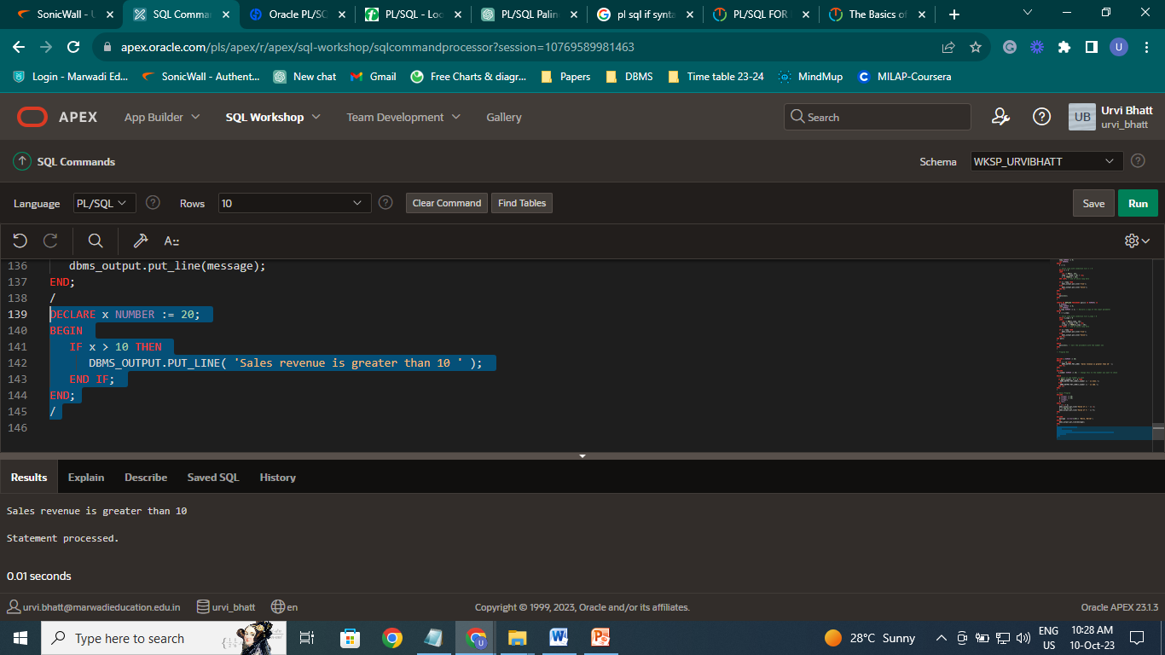
The PL/SQL IF Statement
PL/SQL IF THEN statement
IF condition THEN
statements;
END IF;
Example:
DECLARE
x NUMBER := 20;
BEGIN
IF x > 10 THEN
DBMS_OUTPUT.PUT_LINE( 'Sales revenue is greater than 10 ' );
END IF;
END;
/

Slide 19
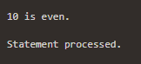
The PL/SQL IF Statement
PL/SQL IF THEN ELSE statement
IF condition THEN
statements;
ELSE
elsestatements;
END IF;
Example:
DECLARE
v_number NUMBER := 10; -- Change this to the number you want to check
BEGIN
-- Check if the number is even
IF MOD(v_number, 2) = 0 THEN
DBMS_OUTPUT.PUT_LINE(v_number || ' is even.');
ELSE
DBMS_OUTPUT.PUT_LINE(v_number || ' is odd.');
END IF;
END;
/

Slide 20
The PL/SQL IF Statement
PL/SQL Nested IF statement
IF condition1 THEN
IF condition2 THEN
nestedifstatements;
END IF;
ELSE
elsestatements;
END IF;

Slide 21
The PL/SQL Case
PL/SQL CASE…
CASE
WHEN VARIABLE = VALUE THEN
<Code>
WHEN VARIABLE = VALUE THEN
<Code>
ELSE
<Code>
END CASE;

Slide 22
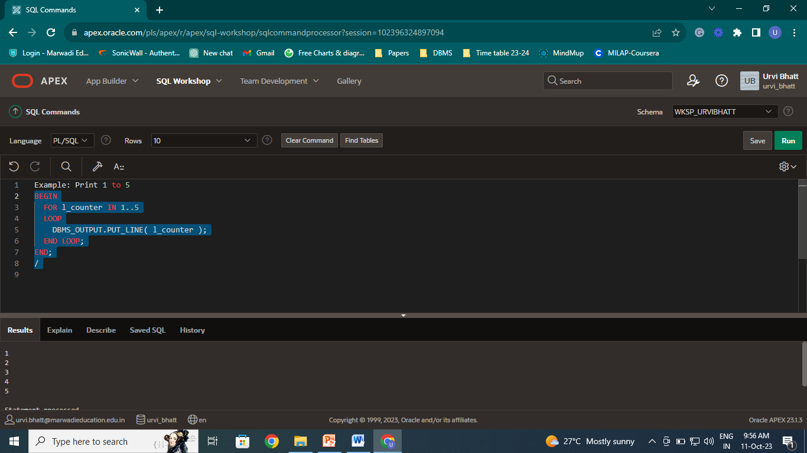
The PL/SQL FOR LOOP
FOR <Variable> IN <Min> .. <Max>
Loop
<Code>
End Loop;
Example: Print 1 to 5
BEGIN
FOR l_counter IN 1..5
LOOP
DBMS_OUTPUT.PUT_LINE( l_counter );
END LOOP;
END;

Slide 23
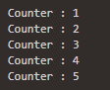
The PL/SQL WHILE LOOP
WHILE condition
LOOP
statements;
END LOOP;
Example: Print 1 to 5
DECLARE
n_counter NUMBER := 1;
BEGIN
WHILE n_counter <= 5
LOOP
DBMS_OUTPUT.PUT_LINE( 'Counter : ' || n_counter );
n_counter := n_counter + 1;
END LOOP;
END;
/

Slide 24
PL/SQL Examples
Write a PL/SQL block to find maximum of 2 numbers
declare
x number(5);
y number(5);
begin
x:=10;
y:=20;
if x > y then
DBMS_OUTPUT.PUT_LINE(''|| x ||' is greater than '|| y ||'');
else
DBMS_OUTPUT.PUT_LINE(''|| y ||' is greater than '|| x ||'');
end if;
end;

Slide 25
PL/SQL Examples
Write a PL/SQL block to find area of rectangle, square and circle
declare
area_c number(6, 2) ;
radius number(1) := 3 ;
area_r number(6) ;
area_s number(6) ;
length number(2) ;
width number(2) ;
pi constant number(3, 2) := 3.14;
begin
area_c := pi * radius * radius;
DBMS_OUTPUT.PUT_LINE('Circle area = ' || area_c);
area_r := length * width;
DBMS_OUTPUT.PUT_LINE('Rectangle area = ' || area_r);
area_s := length * length;
DBMS_OUTPUT.PUT_LINE('Square area = ' || area_s);
end;

Slide 26
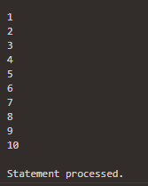
The PL/SQL EXAMPLE
Example: Write a Pl/SQL program to print integers from 1 to 10 by using PL/SQL FOR loop
DECLARE
n number:= 10;
BEGIN
for i in 1..n loop
DBMS_OUTPUT.PUT_LINE(i);
END LOOP;
END;
/

Slide 27
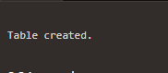
The PL/SQL EXAMPLE
Example: Write a Pl/SQL program using FOR loop to insert ten rows into a database table.
Step 1: Create a temp table as follow:
create table temp1
(
no number(5,2),
detail varchar2(50)
);

Slide 28

The PL/SQL EXAMPLE
Step 2: Write PL/SQL for Inserting ten Rows
DECLARE
BEGIN
FOR i IN 1..10 LOOP
IF MOD(i,2) = 0 THEN -- i is even
INSERT INTO temp1 VALUES (i, 'i is even');
ELSE
INSERT INTO temp1 VALUES (i, 'i is odd');
END IF;
END LOOP;
COMMIT;
END;
/

Slide 29
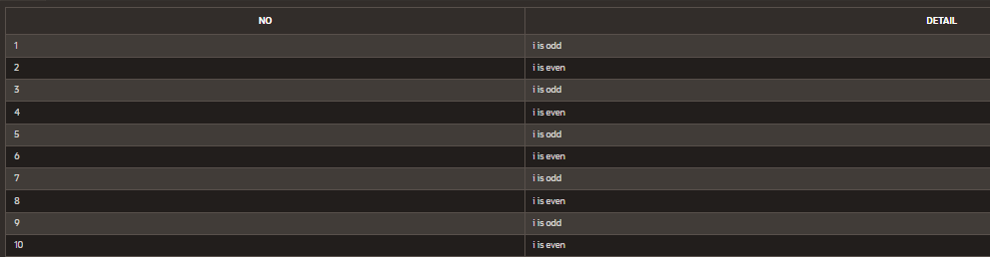
The PL/SQL EXAMPLE
Step 3: To check the data is inserted into table:
select * from temp1;

Slide 30
PL/SQL Sample Program (with user input)
DECLARE
v_inv_value number(8,2);
v_price number(8,2);
v_quantity number(8,0) := 400;
BEGIN
v_price := &V_price;
v_inv_value := v_price * v_quantity;
dbms_output.put_line('******');
dbms_output.put_line('price * quantity=');
dbms_output.put_line(v_inv_value);
END;
/
Note: PL/SQL not designed for user interface programming

Slide 31
PL/SQL
%RowType
Variable Name TableName%RowType
acc account%RowType;
- This “acc” variable will have complete structure of the table account. Any column of account table can be referred using “acc” variable
DECLARE
acc account%RowType;
BEGIN
select * into acc from account where acc_no=‘A001’;
DBMS_OUTPUT.PUT_LINE (acc.name);
DBMS_OUTPUT.PUT_LINE (acc.city);
DBMS_OUTPUT.PUT_LINE (acc.balance);
DBMS_OUTPUT.PUT_LINE (acc.loan_taken);
END;

Slide 32
Stored Procedure(Stored Programs)
A program unit is a self-contained group of program statements that can be used within a large program
Stored PL/SQL program units are program units that other PL/SQL program can reference and that other database users can use and execute.
Can receive multiple input parameters and return multiple output values (or no output values) and perform DML Commands
CREATE [OR REPLACE] PROCEDURE procedure_name [ (parameter mod datatype [,parameter]) ]
IS /AS
[local variable declaration_section]
BEGIN
executable_section
[EXCEPTION
exception_section]
END [procedure_name];
Header
Section
body
Exception
section

Slide 33
PL / SQL Stored Procedure(Stored Programs)
A PL/SQL procedure is a reusable unit that encapsulates the specific business logic of the application
A Procedure in PL/SQL is a subprogram unit that consists of a group of PL/SQL statements that can be called by name.
Each procedure in PL/SQL has its own unique name by which it can be referred to and called.
This subprogram unit in the Oracle database is stored as a database object.

Slide 34
Stored Procedure(Stored Programs)
The header section defines:
1. The procedure name (name should be unique )
2. The parameters that the procedure receives or delivers
(IN, OUT, IN OUT)
3. IS keyword: follows the parameters list
4. The local procedure variables
Create or replace: instructs the DBMS to create the procedure if it does it exists, otherwise; it replaces the existing one
OR REPLACE clause is optional. But if omitted and a procedure exists with the same name, an error occurs
Parameter name, mod and data type are enclosed in parentheses, each is separated by a comma.
Parameter mod: describes how the procedure change the value. It can be:
1. IN: passed parameter is a Read only value. Cannot be changed by the procedure
2. OUT: write-only value. Always comes on the left side of an assignment statement
3. IN OUT: its value can be changed

Slide 35
PL / SQL Stored Procedure(Stored Programs)
Syntax:
CREATE [OR REPLACE] PROCEDURE procedurename
[(parametername [IN | OUT | IN OUT] type [, ...])]
{IS | AS}
BEGIN
< procedurebody >
END procedurename;
Where
procedure-name - specifies the name of the procedure.
[OR REPLACE] - allows the modification of an existing procedure.
The optional parameter list contains name, mode and types of the parameters.
IN represents the value that will be passed from outside
OUT represents the parameter that will be used to return a value outside of the procedure.
procedure-body - contains the executable part.
The AS keyword - is used instead of the IS keyword for creating a standalone procedure.

Slide 36
Stored Procedure(Stored Programs)
EXAMPLE:
CREATE OR REPLACE PROCEDURE greetings
AS
BEGIN
dbms_output.put_line('Hello World!');
END;
The following example creates a simple procedure that displays the string 'Hello World!' on the screen when executed.
Command to Execute the Store Procedure
EXECUTE greetings;
Output: Hello World!

Slide 37
Stored Procedure(Stored Programs)
EXAMPLE:
Create or replace procedure account_update
(
curr_acc_no IN varchar2,
curr_name IN varchar2,
curr_balance IN number
)
IS
BEGIN
update account
set balance = curr_balance
where
acc_no = curr_acc_no and
name = curr_name;
COMMIT;
END;
The Following Stored Procedure updates the balance of the account for a given account number and name of the account.
Command to Execute the Store Procedure
Execute account_update(‘A001’,’Patel’,125000);

Slide 38
The PL/SQL Procedure Example
To delete Procedure:
Syntax: DROP PROCEDURE procedure-name;
Example: DROP PROCEDURE greetings;

Slide 39
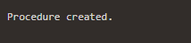
The PL/SQL Procedure Example
Example: Creates a simple procedure that displays the string 'Hello World!' on the screen when executed.
CREATE OR REPLACE PROCEDURE greetings
AS
BEGIN
dbms_output.put_line('Hello World!');
END;
/

Slide 40
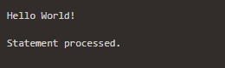
The PL/SQL Procedure Example
To execute Procedure:
Syntax:
BEGIN
Procedure_Name;
END;
/
or
EXECUTE Procedure_Name;
Example:
BEGIN
greetings;
END;
/
or
EXECUTE greetings;

Slide 41
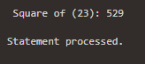
The PL/SQL Procedure Example
Write procedure computes the square of value of a passed value. (This example shows how we can use the same parameter to accept a value and then return another result.)
DECLARE
a number;
PROCEDURE squareNum(x IN OUT number) IS
BEGIN
x := x * x;
END;
BEGIN
a:= 23;
squareNum(a);
dbms_output.put_line(' Square of (23): ' || a);
END;
/

Slide 42
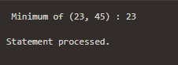
The PL/SQL Procedure Example
Write a Procedure that finds the minimum of two values. (Here, the procedure takes two numbers using the IN mode and returns their minimum using the OUT parameters.)
DECLARE
a number;
b number;
c number;
PROCEDURE findMin(x IN number, y IN number, z OUT number) IS
BEGIN
IF x < y THEN
z:= x;
ELSE
z:= y;
END IF;
END;
BEGIN
a:= 23;
b:= 45;
findMin(a, b, c);
dbms_output.put_line(' Minimum of (23, 45) : ' || c);
END;
/

Slide 43
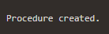
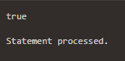
The PL/SQL Procedure Example
Create the procedure for palindrome of given number
CREATE OR REPLACE PROCEDURE pali(n IN NUMBER) IS
m NUMBER;
temp NUMBER := 0;
rem NUMBER;
n_copy NUMBER := n; -- Declare a copy of the input parameter
BEGIN
m := n_copy;
-- while loop with condition till n_copy > 0
WHILE n_copy > 0
LOOP
rem := MOD(n_copy, 10);
temp := (temp * 10) + rem;
n_copy := TRUNC(n_copy / 10);
END LOOP; -- end of while loop here
IF m = temp THEN
dbms_output.put_line('true');
ELSE
dbms_output.put_line('false');
END IF;
END pali;
/
For Execution:
BEGIN
pali(121); -- Call the procedure with the number 121
END;
/

Slide 44
Cursor
A cursor is a private set of records.
A cursor is a pointer that points to a result of a query.
A cursor is a temporary work area created in the system memory when a SQL statement is executed. A cursor contains information on a select statement and the rows of data accessed by it.
This temporary work area is used to store the data retrieved from the database, and manipulate this data. A cursor can hold more than one row, but can process only one row at a time. The set of rows the cursor holds is called the active set.
There are 2 types of Cursors:
Implicit Cursor: Created automatically for every query in SQL.
Explicit Cursor: Created manually by the programmer.

Slide 45
PL / SQL Cursor
A cursor is a pointer that points to a result of a query.
PL/SQL has two types of cursors
implicit cursors
Whenever Oracle executes an SQL statement such as SELECT INTO, INSERT, UPDATE, and DELETE, it automatically creates an implicit cursor.
explicit cursors.
An explicit cursor is a SELECT statement declared explicitly in the declaration section of the current block or a package specification.

Slide 46
Cursor
Cursor Attributes
cursorname%ROWCOUNT Rows returned so far
cursorname%FOUND One or more rows retrieved
cursorname%NOTFOUND No rows found
Cursorname%ISOPEN Is the cursor open

Slide 47
Cursor
Explicit Cursor
Declare the cursor
Open the cursor
Fetch a row
Test for end of cursor
Close the cursor

Slide 48
Cursor
Explicit Cursor Example
DECLARE
CURSOR account_cursor IS SELECT * from account;
acc account%rowtype;
BEGIN
DBMS_OUTPUT.PUT_LINE ('******************');
OPEN account_cursor;
FETCH account_cursor into acc;
WHILE account_cursor % Found
LOOP
DBMS_OUTPUT.PUT_LINE (acc.name);
DBMS_OUTPUT.PUT_LINE (acc.city);
DBMS_OUTPUT.PUT_LINE (acc.balance);
DBMS_OUTPUT.PUT_LINE (acc.loan_taken);
DBMS_OUTPUT.PUT_LINE ('******************');
FETCH account_cursor into acc;
END LOOP;
CLOSE account_cursor;
END;

Slide 49
Create a Table SALESMEN as per Practical 8
CREATE TABLE SALESMEN (
SNUM VARCHAR2(6) CONSTRAINT pksnum PRIMARY KEY CHECK (SNUM LIKE 'S%'),
SNAME VARCHAR2(20) NOT NULL,
CITY VARCHAR2(15),
COMM NUMBER(5, 2)
);
-- Insert data into the SALESMEN table
INSERT INTO SALESMEN (SNUM, SNAME, CITY, COMM) VALUES ('S1001', 'Piyush', 'London', 0.12);
INSERT INTO SALESMEN (SNUM, SNAME, CITY, COMM) VALUES ('S1002', 'Niraj', 'San Jose', 0.13);
INSERT INTO SALESMEN (SNUM, SNAME, CITY, COMM) VALUES ('S1003', 'Miti', 'London', 0.11);
INSERT INTO SALESMEN (SNUM, SNAME, CITY, COMM) VALUES ('S1004', 'Rajesh', 'Barcelona', 0.15);
INSERT INTO SALESMEN (SNUM, SNAME, CITY, COMM) VALUES ('S1005', 'Haresh', 'New York', 0.10);
INSERT INTO SALESMEN (SNUM, SNAME, CITY, COMM) VALUES ('S1006', 'Ram', 'Bombay', 0.10);
INSERT INTO SALESMEN (SNUM, SNAME, CITY, COMM) VALUES ('S1007', 'Nehal', 'Delhi', 0.09);
Select * from SALESMEN;

Slide 50
Create a Table CUSTOMER as per Practical 8
CREATE TABLE CUSTOMER (
CNUM VARCHAR2(6) CONSTRAINT pkcnum PRIMARY KEY CHECK (CNUM LIKE 'C%'),
CNAME VARCHAR2(20) NOT NULL,
CITY VARCHAR2(15),
RATING NUMBER(5),
SNUM VARCHAR2(6) REFERENCES SALESMEN(SNUM)
);
-- Insert data into the CUSTOMER table
INSERT INTO CUSTOMER (CNUM, CNAME, CITY, RATING, SNUM) VALUES ('C2001', 'Hardik', 'London', 100, 'S1001');
INSERT INTO CUSTOMER (CNUM, CNAME, CITY, RATING, SNUM) VALUES ('C2002', 'Geeta', 'Rome', 200, 'S1003');
INSERT INTO CUSTOMER (CNUM, CNAME, CITY, RATING, SNUM) VALUES ('C2003', 'Kavish', 'San Jose', 200, 'S1002');
INSERT INTO CUSTOMER (CNUM, CNAME, CITY, RATING, SNUM) VALUES ('C2004', 'Dhruv', 'Berlin', 300, 'S1002');
INSERT INTO CUSTOMER (CNUM, CNAME, CITY, RATING, SNUM) VALUES ('C2005', 'Pratham', 'London', 100, 'S1001');
INSERT INTO CUSTOMER (CNUM, CNAME, CITY, RATING, SNUM) VALUES ('C2006', 'Vyomesh', 'San Jose', 300, 'S1007');
INSERT INTO CUSTOMER (CNUM, CNAME, CITY, RATING, SNUM) VALUES ('C2007', 'Kirit', 'Rome', 100, 'S1004');
INSERT INTO CUSTOMER (CNUM, CNAME, CITY, RATING, SNUM) VALUES ('C2008', 'Kirit', 'Rome', 100, 'S1004');
select * from Customer

Slide 51
Create a Table Order as per Practical 8
CREATE TABLE "ORDER" (
ONUM VARCHAR2(6) CONSTRAINT pkonum PRIMARY KEY CHECK (ONUM LIKE 'O%'),
AMT NUMBER(10, 2) NOT NULL,
ODATE DATE,
CNUM VARCHAR2(6) REFERENCES CUSTOMER(CNUM),
SNUM VARCHAR2(6) REFERENCES SALESMEN(SNUM)
);
-- Insert data into the ORDER table
INSERT INTO "ORDER" (ONUM, AMT, ODATE, CNUM, SNUM) VALUES ('O3001', 18.69, TO_DATE('10-Mar-90', 'DD-Mon-RR'), 'C2008', 'S1007');
INSERT INTO "ORDER" (ONUM, AMT, ODATE, CNUM, SNUM) VALUES ('O3003', 767.19, TO_DATE('10-Mar-90', 'DD-Mon-RR'), 'C2001', 'S1001');
INSERT INTO "ORDER" (ONUM, AMT, ODATE, CNUM, SNUM) VALUES ('O3002', 1900.10, TO_DATE('03-Oct-90', 'DD-Mon-RR'), 'C2007', 'S1004');
INSERT INTO "ORDER" (ONUM, AMT, ODATE, CNUM, SNUM) VALUES ('O3005', 5160.45, TO_DATE('04-Oct-90', 'DD-Mon-RR'), 'C2003', 'S1002');
INSERT INTO "ORDER" (ONUM, AMT, ODATE, CNUM, SNUM) VALUES ('O3006', 1098.16, TO_DATE('10-Mar-90', 'DD-Mon-RR'), 'C2008', 'S1007');
INSERT INTO "ORDER" (ONUM, AMT, ODATE, CNUM, SNUM) VALUES ('O3009', 1713.23, TO_DATE('10-Apr-90', 'DD-Mon-RR'), 'C2002', 'S1003');
INSERT INTO "ORDER" (ONUM, AMT, ODATE, CNUM, SNUM) VALUES ('O3007', 75.75, TO_DATE('10-Apr-90', 'DD-Mon-RR'), 'C2004', 'S1002');
INSERT INTO "ORDER" (ONUM, AMT, ODATE, CNUM, SNUM) VALUES ('O3008', 4723.00, TO_DATE('10-May-90', 'DD-Mon-RR'), 'C2006', 'S1001');
INSERT INTO "ORDER" (ONUM, AMT, ODATE, CNUM, SNUM) VALUES ('O3010', 1309.95, TO_DATE('10-May-90', 'DD-Mon-RR'), 'C2004', 'S1002');
INSERT INTO "ORDER" (ONUM, AMT, ODATE, CNUM, SNUM) VALUES ('O3011', 9891.88, TO_DATE('10-Jun-90', 'DD-Mon-RR'), 'C2006', 'S1001');
Select * from "ORDER";

Slide 52
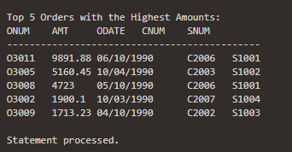
Given the table ORDER (ONUM, AMT, ODATE, CNUM, SNUM) write a cursor to select the five highest amount (AMT) order details from the table.
DECLARE
CURSOR top_orders_cursor IS
SELECT ONUM, AMT, ODATE, CNUM, SNUM
FROM "ORDER"
ORDER BY AMT DESC
FETCH FIRST 5 ROWS ONLY;
v_onum "ORDER".ONUM%TYPE;
v_amt "ORDER".AMT%TYPE;
v_odate "ORDER".ODATE%TYPE;
v_cnum "ORDER".CNUM%TYPE;
v_snum "ORDER".SNUM%TYPE;
BEGIN
OPEN top_orders_cursor;
FETCH top_orders_cursor INTO v_onum, v_amt, v_odate, v_cnum, v_snum;
DBMS_OUTPUT.PUT_LINE('Top 5 Orders with the Highest Amounts:');
DBMS_OUTPUT.PUT_LINE('ONUM' || CHR(9) || 'AMT' || CHR(9) || 'ODATE' || CHR(9) || 'CNUM' || CHR(9) || 'SNUM');
DBMS_OUTPUT.PUT_LINE('---------------------------------------------');
WHILE top_orders_cursor%FOUND LOOP
DBMS_OUTPUT.PUT_LINE(v_onum || CHR(9) || v_amt || CHR(9) || v_odate || CHR(9) || v_cnum || CHR(9) || v_snum);
FETCH top_orders_cursor INTO v_onum, v_amt, v_odate, v_cnum, v_snum;
END LOOP;
CLOSE top_orders_cursor;
END;
/

Slide 53
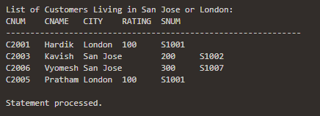
To write a Cursor to display the list of customers who are living in San jose or London.
DECLARE
CURSOR customer_cursor IS
SELECT CNUM, CNAME, CITY, RATING, SNUM
FROM CUSTOMER
WHERE CITY IN ('San Jose', 'London');
v_cnum CUSTOMER.CNUM%TYPE;
v_cname CUSTOMER.CNAME%TYPE;
v_city CUSTOMER.CITY%TYPE;
v_rating CUSTOMER.RATING%TYPE;
v_snum CUSTOMER.SNUM%TYPE;
BEGIN
OPEN customer_cursor;
FETCH customer_cursor INTO v_cnum, v_cname, v_city, v_rating, v_snum;
DBMS_OUTPUT.PUT_LINE('List of Customers Living in San Jose or London:');
DBMS_OUTPUT.PUT_LINE('CNUM' || CHR(9) || 'CNAME' || CHR(9) || 'CITY' || CHR(9) || 'RATING' || CHR(9) || 'SNUM');
DBMS_OUTPUT.PUT_LINE('-------------------------------------------------------------');
WHILE customer_cursor%FOUND LOOP
DBMS_OUTPUT.PUT_LINE(v_cnum || CHR(9) || v_cname || CHR(9) || v_city || CHR(9) || v_rating || CHR(9) || v_snum);
FETCH customer_cursor INTO v_cnum, v_cname, v_city, v_rating, v_snum;
END LOOP;
CLOSE customer_cursor;
END;
/

Slide 54
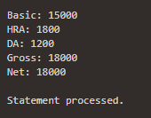
Calculate hra,da, gross and net by using PL/SQL program
DECLARE
v_basic NUMBER := 15000; -- Replace with the desired basic salary
v_hra NUMBER;
v_da NUMBER;
v_gross NUMBER;
v_net NUMBER;
BEGIN
-- Calculate HRA based on the given rules
CASE
WHEN v_basic = 15000 THEN
v_hra := v_basic * 0.12;
v_da := v_basic * 0.08;
WHEN v_basic = 12000 THEN
v_hra := v_basic * 0.10;
v_da := v_basic * 0.06;
WHEN v_basic = 9000 THEN
v_hra := v_basic * 0.07;
v_da := v_basic * 0.04;
ELSE
v_hra := v_basic * 0.05;
v_da := 200;
END CASE;
-- Calculate Gross and Net
v_gross := v_basic + v_hra + v_da;
v_net := v_gross - (CASE WHEN v_basic = 15000 THEN 0 ELSE 200 END);
-- Output the results
DBMS_OUTPUT.PUT_LINE('Basic: ' || v_basic);
DBMS_OUTPUT.PUT_LINE('HRA: ' || v_hra);
DBMS_OUTPUT.PUT_LINE('DA: ' || v_da);
DBMS_OUTPUT.PUT_LINE('Gross: ' || v_gross);
DBMS_OUTPUT.PUT_LINE('Net: ' || v_net);
END;
Basic | HRA | DA
15000 | 12% | 8%
12000 | 10% | 6%
9000 | 7% | 4%
OTHERS | 5% | 200/-

Slide 55
Function
A function is similar to a procedure, except that it returns a single value.
Functions can accept one, many, or no parameters, but a function must have a return clause in the executable section of the function.
The datatype of the return value must be declared in the header of the function.
The syntax for creating a function is as follows:
CREATE [OR REPLACE] FUNCTION function_name
(parameter list)
RETURN datatype
IS/AS
BEGIN
<body>
RETURN (return_value);
END;

Slide 56
Function
The Following Function will fetch the name of the account for a given account number.
2 Ways to Execute the Function:
DECLARE
acc_name VARCHAR2(30);
BEGIN
acc_name := account_det(&account_num);
DBMS_OUTPUT.PUT_LINE(acc_name);
END;
EXAMPLE:
Create or replace function account_det
(account_num varchar2)
RETURN varchar2
IS
acc_name varchar2(30);
BEGIN
select name into acc_name from
account where acc_no=account_num;
RETURN acc_name;
END;
Select account_det(acc_no) from account;

Slide 57
Function
Write a function to accept employee number as parameter and return Basic +HRA together as single column
EXAMPLE:
CREATE OR REPLACE FUNCTION calculate_total_salary(p_emp_number NUMBER)
RETURN NUMBER
IS
v_basic_salary NUMBER;
v_hra NUMBER;
v_total_salary NUMBER;
BEGIN
-- Assuming you have a table named employees with columns emp_number, basic_salary, and hra
SELECT basic, hra
INTO v_basic_salary, v_hra
FROM employees
WHERE emp_number = p_emp_number;
v_total_salary := v_basic_salary + v_hra;
RETURN v_total_salary;
END;
/
TO run: Select calculate_total_salary (emp_number) from account;
To run:
DECLARE
v_total_salary NUMBER;
BEGIN
v_total_salary := calculate_total_salary(123); -- Replace 123 with the desired employee number
DBMS_OUTPUT.PUT_LINE('Total Salary: ' || v_total_salary);
END;

Slide 58
Trigger
A trigger is a block structure which is fired when a DML statements like Insert, Delete, Update is executed on a database table. A trigger is triggered automatically when an associated DML statement is executed.
Syntax of Triggers
CREATE [OR REPLACE ] TRIGGER trigger_name
{BEFORE | AFTER}
{INSERT [OR] | UPDATE [OR] | DELETE}
[OF col_name]
ON table_name
[REFERENCING OLD AS o NEW AS n]
[FOR EACH ROW]
WHEN (condition) ;
Note:[REFERENCING OLD AS o NEW AS n] − This allows you to refer new and old values for various DML statements, such as INSERT, UPDATE, and DELETE.
Notes:
CREATE [OR REPLACE] TRIGGER trigger_name − Creates or replaces an existing trigger with the trigger_name.
{BEFORE | AFTER | INSTEAD OF} − This specifies when the trigger will be executed. The INSTEAD OF clause is used for creating trigger on a view.
{INSERT [OR] | UPDATE [OR] | DELETE} − This specifies the DML operation.
[OF col_name] − This specifies the column name that will be updated.
[ON table_name] − This specifies the name of the table associated with the trigger.
[REFERENCING OLD AS o NEW AS n] − This allows you to refer new and old values for various DML statements, such as INSERT, UPDATE, and DELETE.
[FOR EACH ROW] − This specifies a row-level trigger, i.e., the trigger will be executed for each row being affected. Otherwise the trigger will execute just once when the SQL statement is executed, which is called a table level trigger.
WHEN (condition) − This provides a condition for rows for which the trigger would fire. This clause is valid only for row-level triggers.

Slide 59
Trigger
The syntax for a dropping a Trigger is:
DROP TRIGGER trigger_name ON tbl_name;
The syntax for a disabling a Trigger is:
ALTER TRIGGER trigger_name DISABLE;
The syntax for a enabling a Trigger is:
ALTER TRIGGER trigger_name ENABLE;

Slide 60
Trigger
Creating Trigger
1.
CREATE TRIGGER deleted_details
BEFORE
DELETE on loan
FOR EACH ROW
2.
CREATE TRIGGER inserted_details
after
insert on transaction
FOR EACH ROW

Slide 61
Trigger
Creating Trigger
3.
CREATE TRIGGER updated_details
BEFORE
UPDATE on account
FOR EACH ROW when name=‘Patel Hiren’;
Deleting Trigger
Drop trigger inserted_details on account;

Slide 62
Trigger
Understand and Implement Triggers.
1. Whenever order amount is updated and its value becomes more than 5000 a trigger
has to be raised preventing the operation.
CREATE OR REPLACE TRIGGER prevent_high_order_amount
BEFORE UPDATE OF order_amount ON “order”
FOR EACH ROW
BEGIN
IF :NEW.order_amount > 5000 THEN
RAISE_APPLICATION_ERROR(-20001, 'Order amount cannot exceed 5000');
END IF;
END;

Slide 63
Thank
You

